Slide 1
Nested queries
Prepared By
Sana Batool

Slide 2
Nested queries (subqueries)
A subquery(inner query) is a SQL query nested inside a another query(outer query)
A subquery may occur in :
SELECT clause of outer query
FROM clause of outer query
WHERE clause of outer query (most commonly used)
A subquery can be nested inside:
SELECT statement
INSERT statement
UPDATE statement
DELETE statement
another subquery.

Slide 3
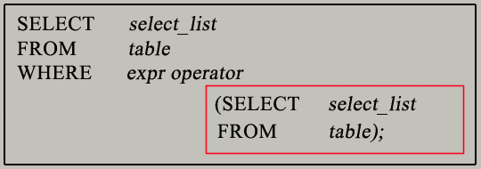
Basic Syntax

Slide 4
Execution Order
Inner query evaluated independently of the outer query
Inner query is executed first
Inner query is executed only one time
The result of inner query is then passed to outer query for further processing

Slide 5
Operators Usually used
Comparison operator
<
>
=
<=
>=
<>
Multiple row comparison operator
IN
ANY (SOME)
ALL

Slide 6


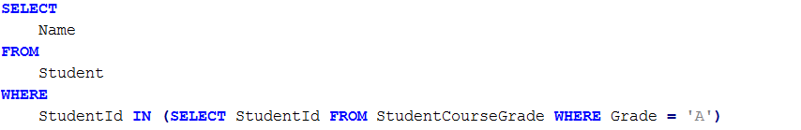
Examples
SELECT clause
FROM clause
WHERE clause

Slide 7
Examples
INSERT statement
UPDATE statement
DELETE statement

Slide 8
Correlated Nested queries
A subquery can contains reference to the table of the outer query(outer reference)
The subquery which contains the outer reference is called correlated subquery

Slide 9
Execution Order
Correlated subquery cannot be evaluated independently of the outer query.
Because the correlated subquery uses the values of the outer query, so the outer query is executed first
Correlated query is executed for every row of the outer query

Slide 10
Question
Can you figure out correlated subquery from Slide 6 Examples?

Slide 11
Points to remember
Subquery must be enclosed in parentheses
Subquery must be placed on right side of comparison operator
Use single-row operators with single-row subqueries
If the WHERE clause of an outer query includes a column name, it must be join-compatible with the column in the subquery select list.
ORDER BY can only be specified in subquery if TOP is also specified
In correlated nested queries, a table alias must be used to specify which table reference is to be used.

